Slide 1
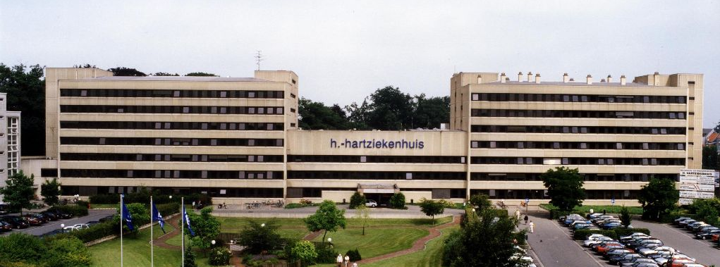
Abductorcuff repair
Dr Jan Myncke
Dr Catherine Gorris
Matti Vervloet
H Hart Lier

Slide 2
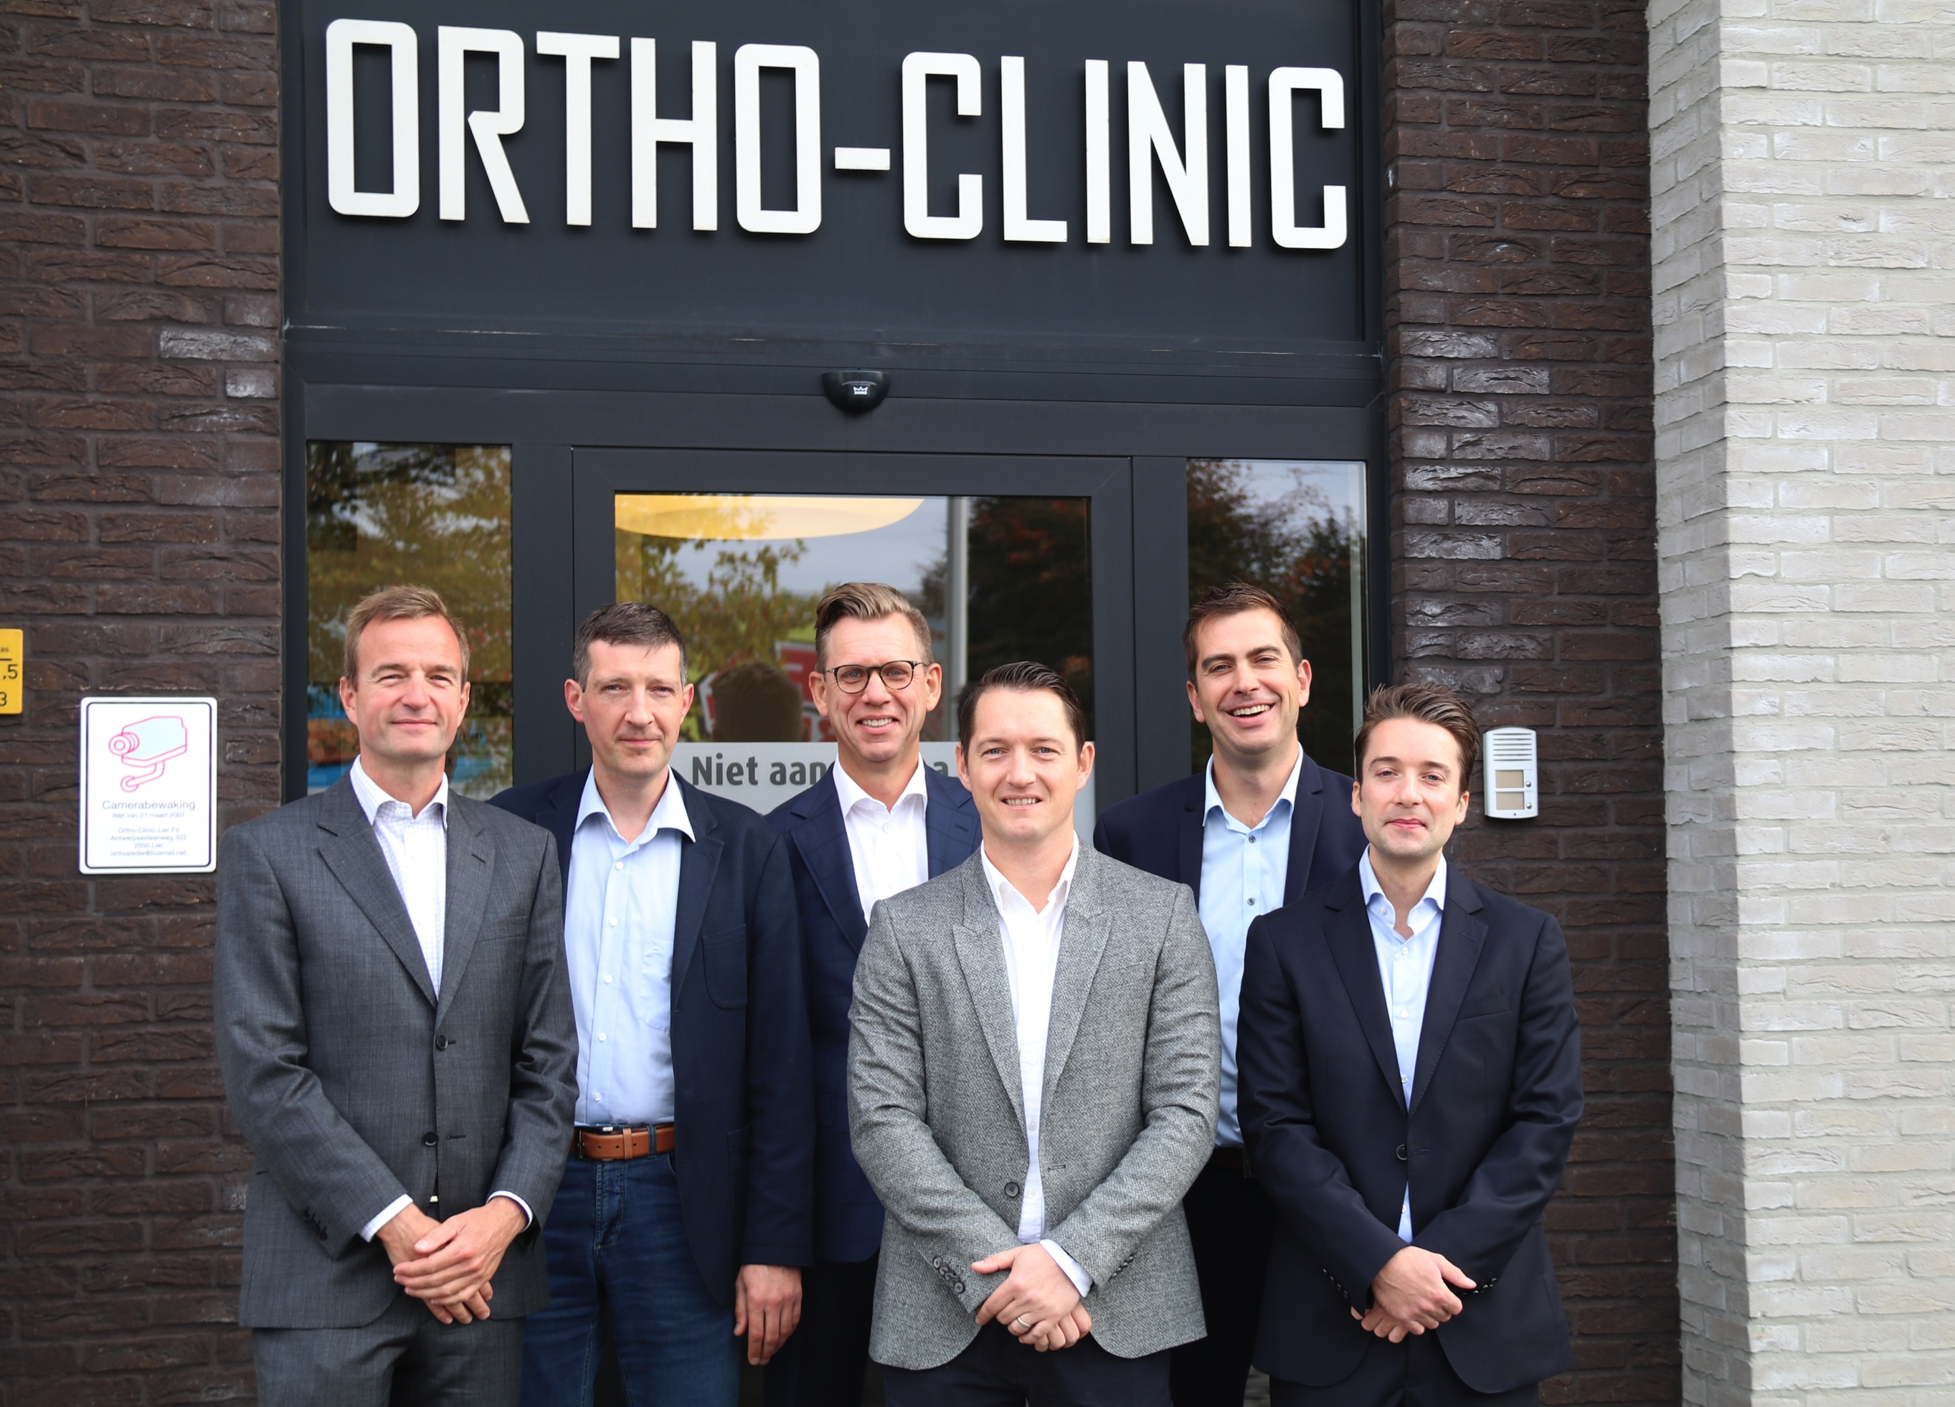

Slide 4
Incidence
Greater trochanter pain syndrome (GTPS)
Segal et al. Arch Phys Med Rehad, 2007
3026 adults 50-79 jaar
Women: 15 % unilateral, 8,5% bilateral
Men: 6,6% unilateral, 1,9% bilateaal
Williams et al. Anesth Analg, 2009
Estimated incidence 1,8/1000 persons

Slide 5
Incidence
Bunker, JBJS Br, 1997
50 patients with hip fracture: 20% rupture
Hendry, Arch Ortho Traumat Surg, 2012
835 THA, 25% gluteal tendon tear, elderly women

Slide 6
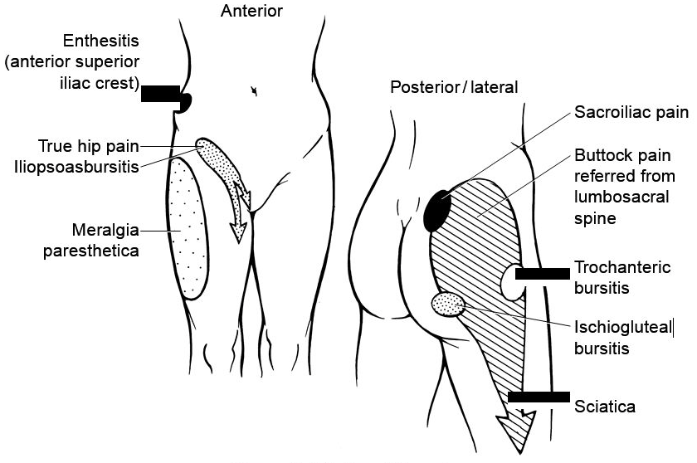
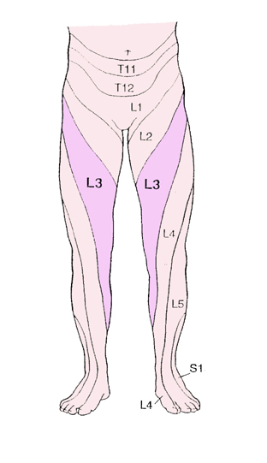
GTPS: Differential diagnosis
Extra-articular:
External snapping hip
Bursitis
Insertion tendinopathy gluteii
Internal snapping hip (iliopsoas), piriformis, ischiofemoraal impingement,
Intra-articular: coxartrosis? Femoro-acetabulair impingement?
Referred: lower spine (L3-L4), renal diseases, …

Slide 7
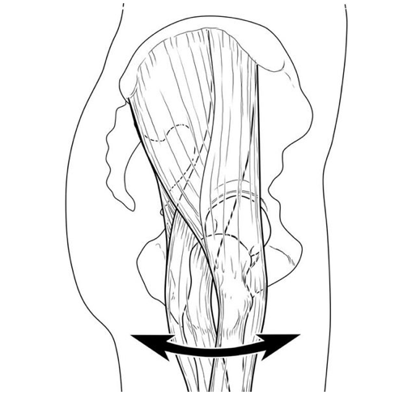
External snapping hip
Fascia jumps over greater trochanter
Somethimes visible, audible click
Ethiology: low muscle belly of tensor fascia, lateralised greater trochanter, ...
Often asymptomatic
Possible cause of trochanteric bursitis

Slide 8
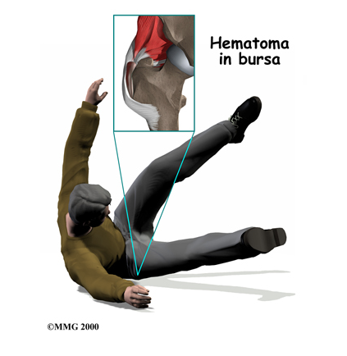
Trochanteric bursitis
Inflammation of bursa trochanterica
Symptoms:
Pain lateral of the hip
Pain after excercise
Local tenderness on palpation
Causes:
Direct impact
Overuse ?

Slide 9
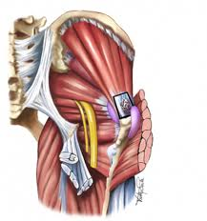
Abductor cuff tendinopathy
Insertion tendinopathy of gluteus medius – minimus on trochanter
Tendon degeneration – inflammation (tendinitis) - partial thickness tear – full thickness tear
Causes:
Degenerative
After direct impact
After THP (anterolateral approach)

Slide 10
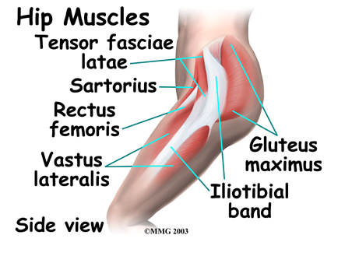
Anatomy
Fascia lata

Slide 11
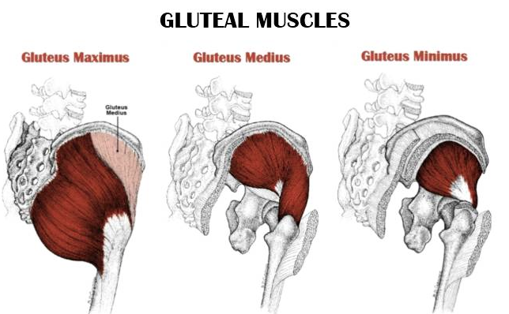
Anatomy

Slide 12
Anatomy
Insertion on trochanter
Gluteus minimus
Anterior facet
Anterior en superior capsula of hip
Gluteus medius
Anterior + middle part on lateral facet
Posterior part on superoposterior facet

Slide 13
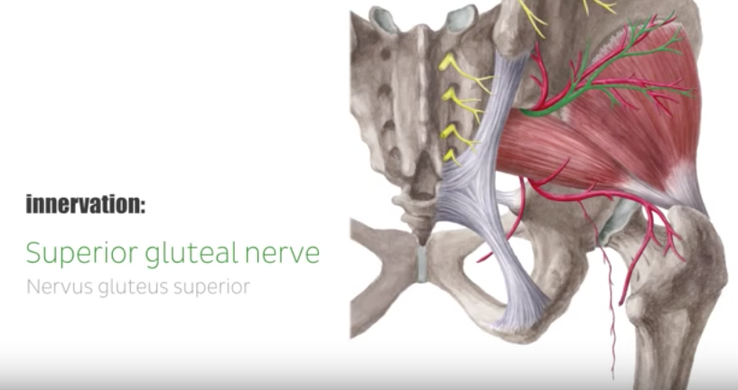
Anatomy

Slide 14
Functional anatomy gluteus minimus: flexion hip

Slide 15
Functional anatomy gluteus minimus: endorotation hip

Slide 16
Functional anatomy gluteus minimus: anteversion

Slide 17
Functional anatomy glut minimus + medius: abduction

Slide 18
Functional anatomy glut min + max: pelvic balans

Slide 19
Functional anatomy gluteus medius: abduction

Slide 20
Functional anatomy glut med + min: pelvis horizontal

Slide 21
Symptoms
Pain lateral tigh
Pain lateral knee
Pain climbing stairs
Limited number of stairs possible
Difficult sleeping on the side

Slide 22
Clinical examination ?
Standing on 1 leg
Mobility hip: nl
Lateral decubitus
Abduction hip extended – knee extended
Abduction hip extended – knee flexed
Abduction hip flexed – knee flexed

Slide 23
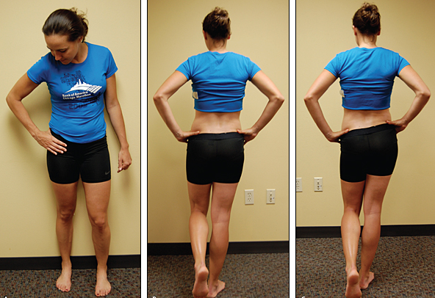
Clinical examination
Monopodal standing 30’: Trendelenburg ?

Slide 24
Clinical examination
Abduction with hip + knee in extension
= iliotibial band + gluteus medius + glut minimus

Slide 25
Clinical examination
Abduction with hip flexed + knee flexed
= gluteus medius

Slide 26
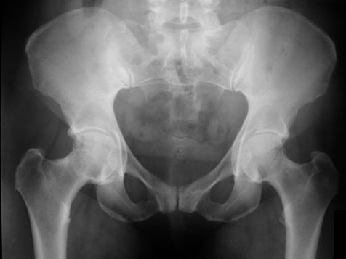
Standing RX pelvis
leg length
pelvic tilt
Rotation
Overview hip, SIG

Slide 27
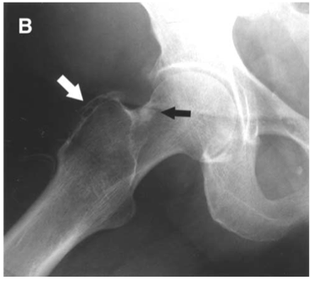
RX hip F/ P /Dunn
+ Dunn-view to exclude FAI
Calcification ? Enthesiophyt ?

Slide 28
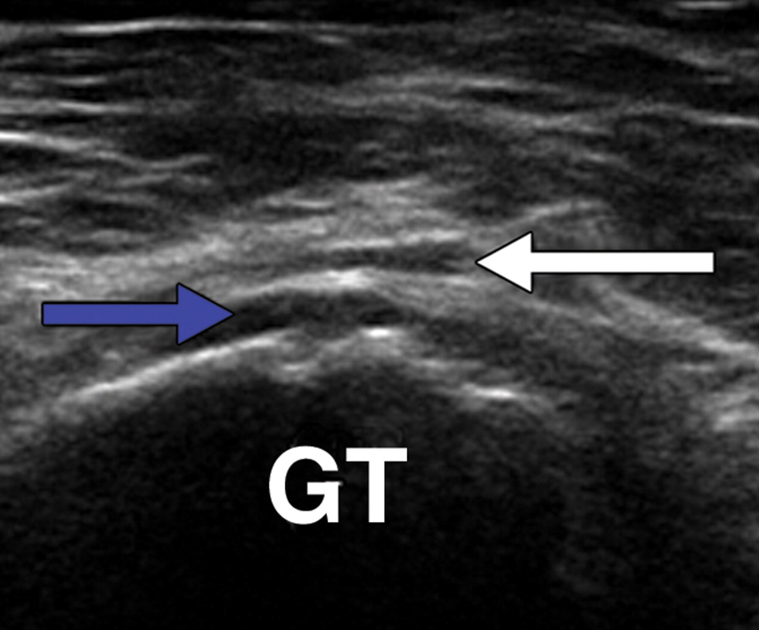
Echography
Bursitis?
Gluteus medius / minimus?
Articular tears
Difficult if obese

Slide 29
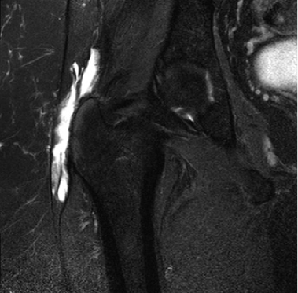
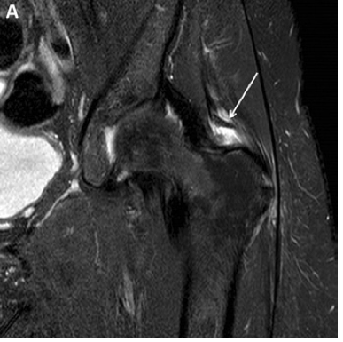
MRI pelvis
MRI detection of abducturcufftears: 73% sensitivity 95% specificity. Howell GE. J Arthroplasty 2001

Slide 30
MRI pelvis
Tendon tear? Muscle degeneration?

Slide 31
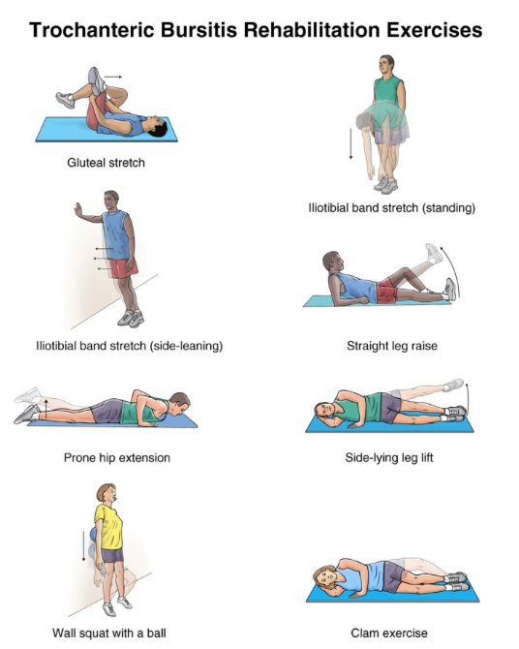
Conservative treatment
NSAID
Elevation contralateral leg
Fysio / fitness:
Pelvic stabilisation exercises
Stretching fascia lata
Eccentric training

Slide 32
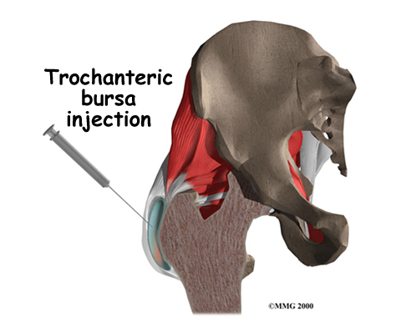
Conservative treatment
ESWT
Insertion tendinopathy
Contra-indicated if (partial) tear of the abductorcuff ?
Infiltration cortisone
Bursitis trochanterica
No resistance !
Cortisone and tendon tears?

Slide 33
Conservative treatment
Infiltration PRP ?
Fitzpatrick J. Am J Sports Med 2018
Level 1 randomized; double-blind controlled trial
80/228 enrolled
included: buritis - tendinopathie – partial tear
(excluded: full thickness tear, previous surgery, osteoartritis, sciatica,..)
Conclusion: tendinopathy >4m greater clinical improvement after 12w with single PRP injection compared to single cortisone

Slide 34
Operative treatment
Primary repair : suture anchors
Open
Endoscopic
Transposition
Gluteus maximus transfert
Fascia lata tenodesis
Vastus lateralis transfert
Tissue augmentation

Slide 35
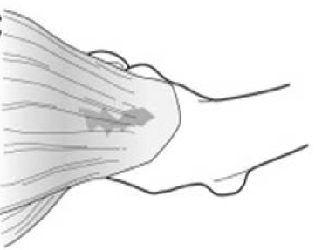
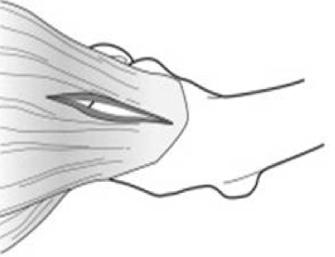
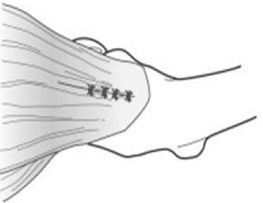
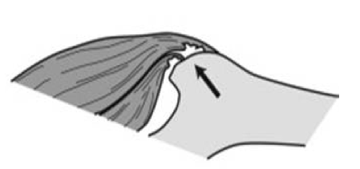
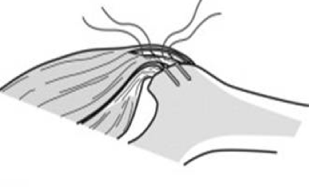
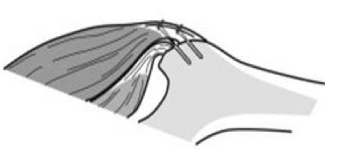
Open primary repair
Partial thickness tear
Excision bursa if inflamed
NO resection of fascia lata

Slide 36
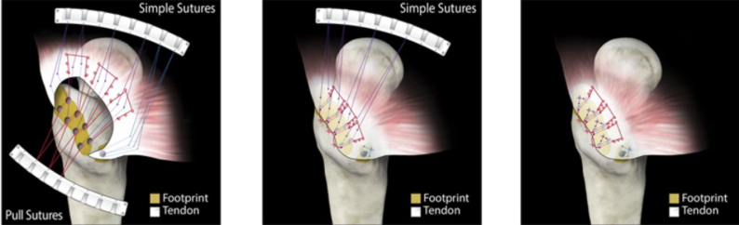
Open primary repair
Full thickness tear
Double row?

Slide 37
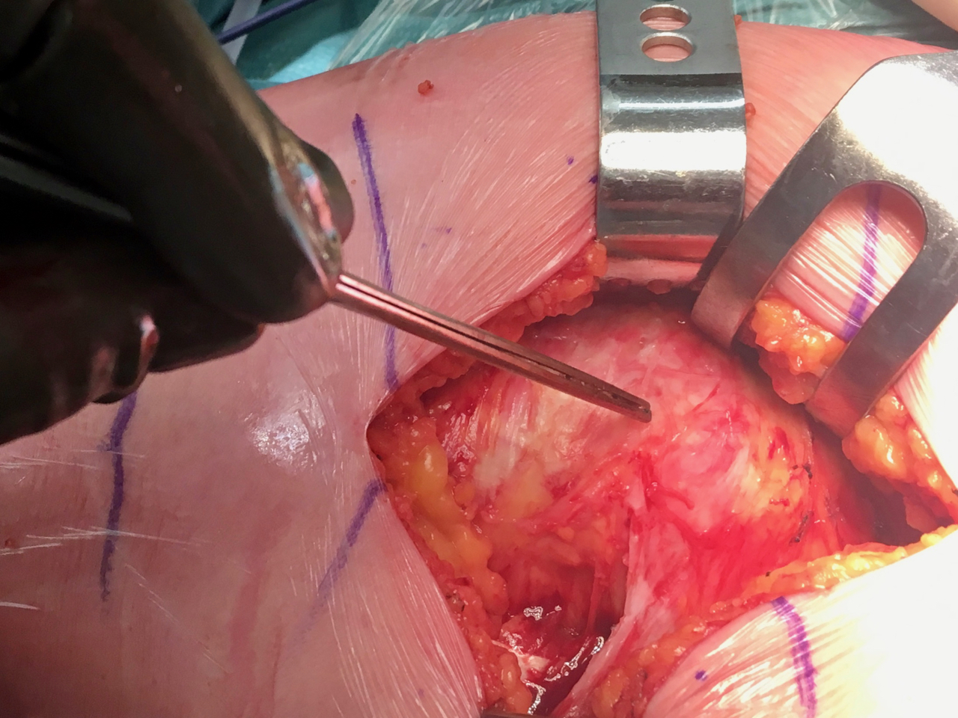
Open primary repair

Slide 38
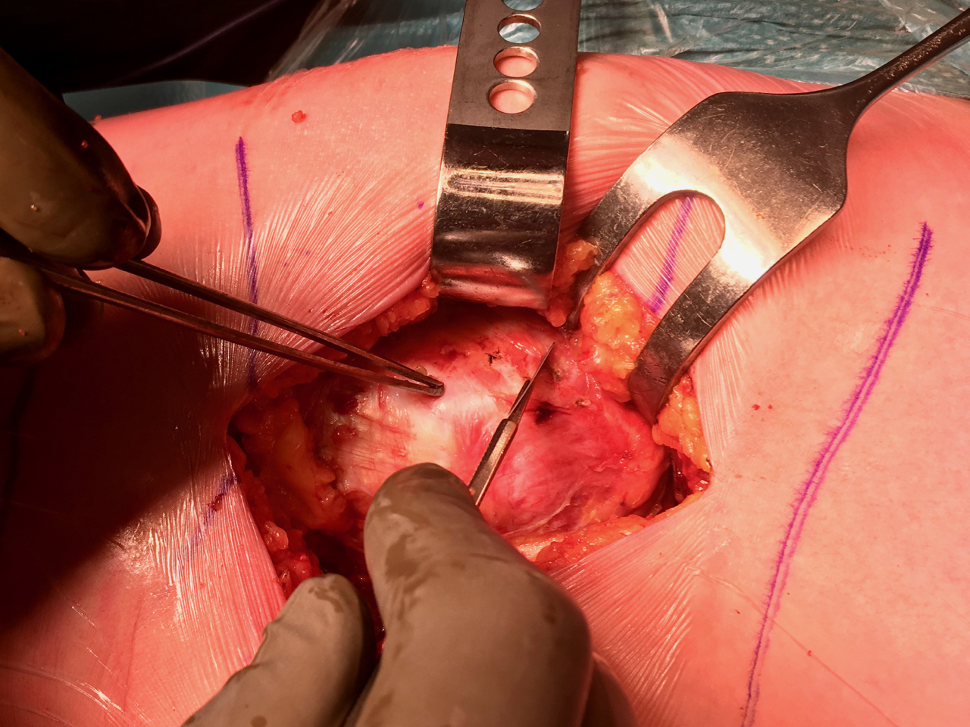
Open primary repair

Slide 39
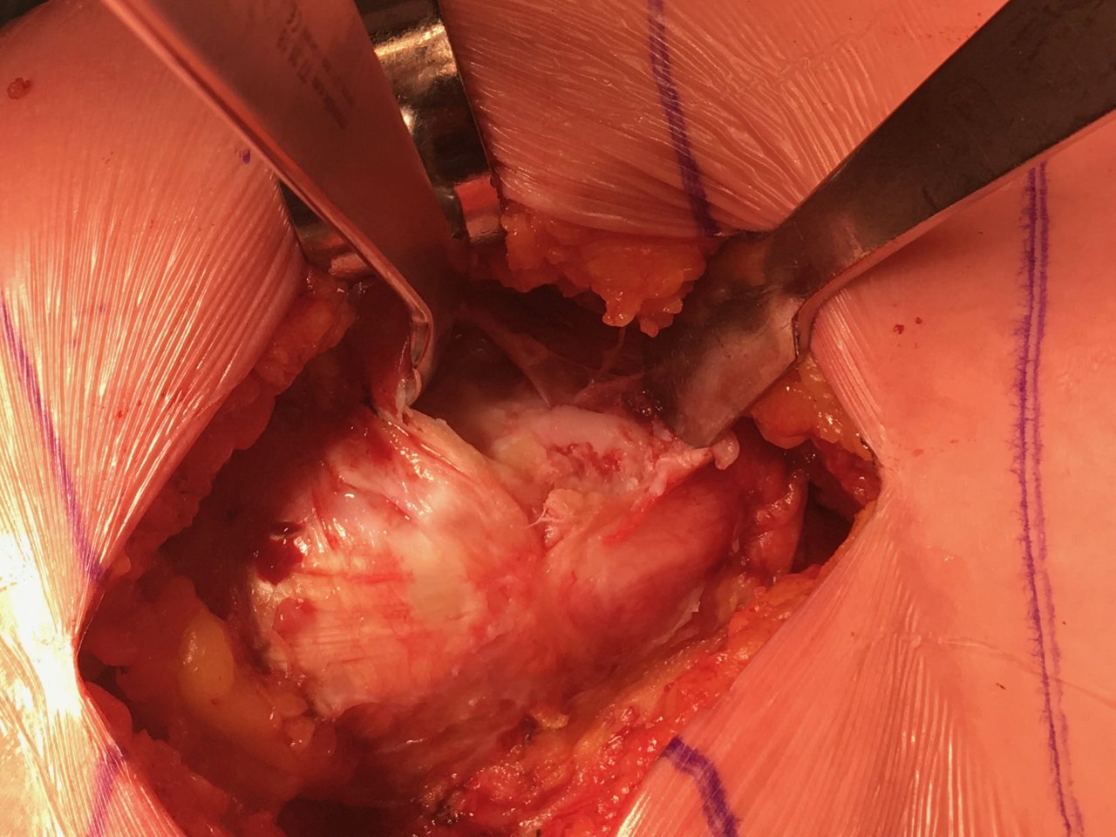
Open primary repair

Slide 40
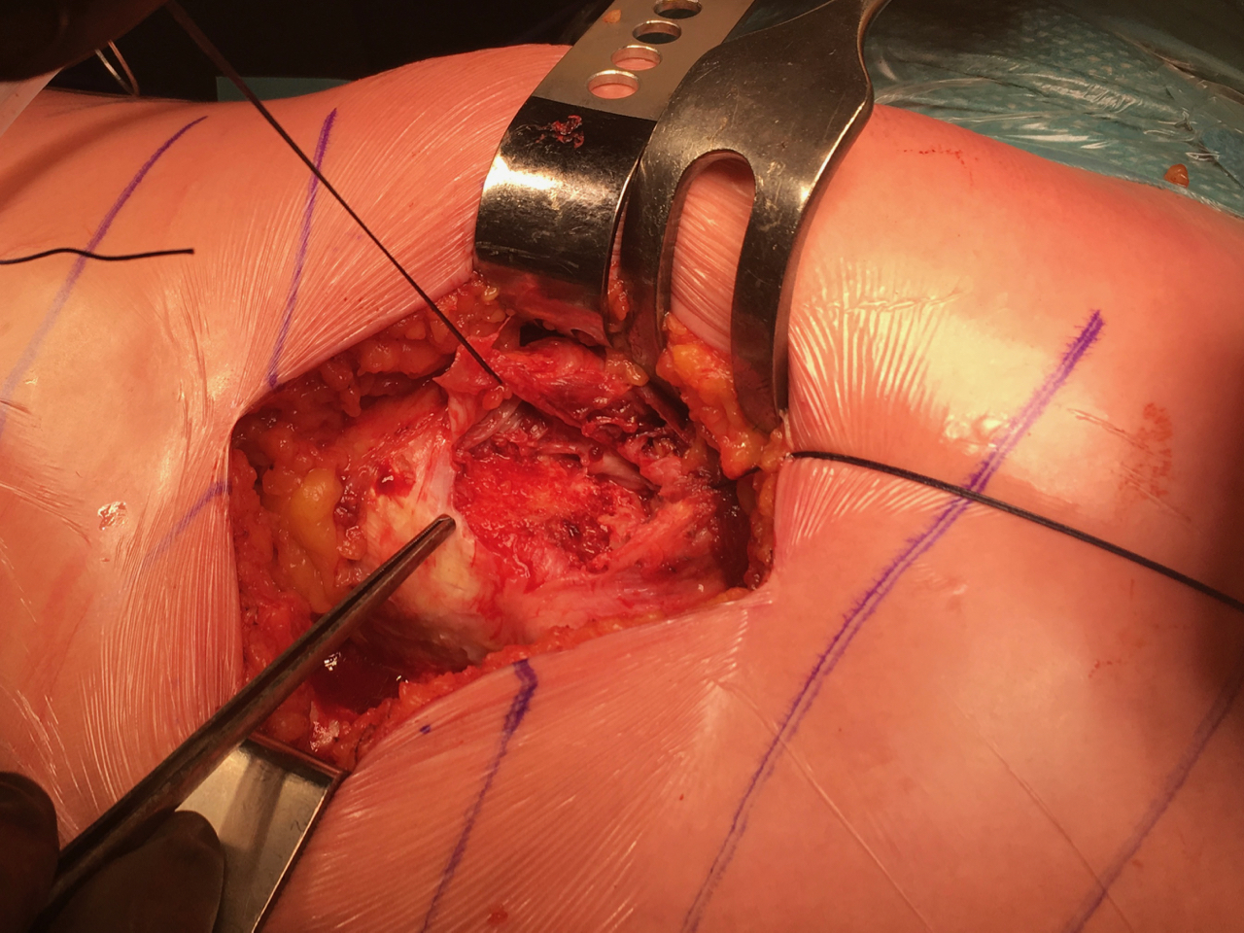
Open primary repair

Slide 41
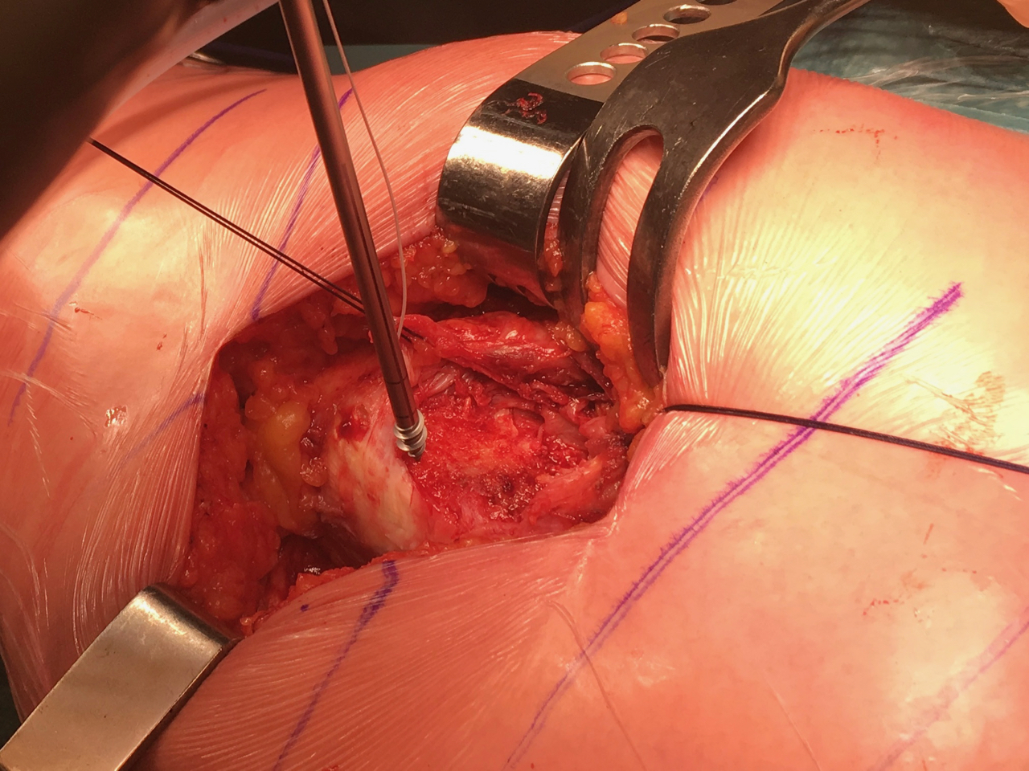
Open primary repair

Slide 42
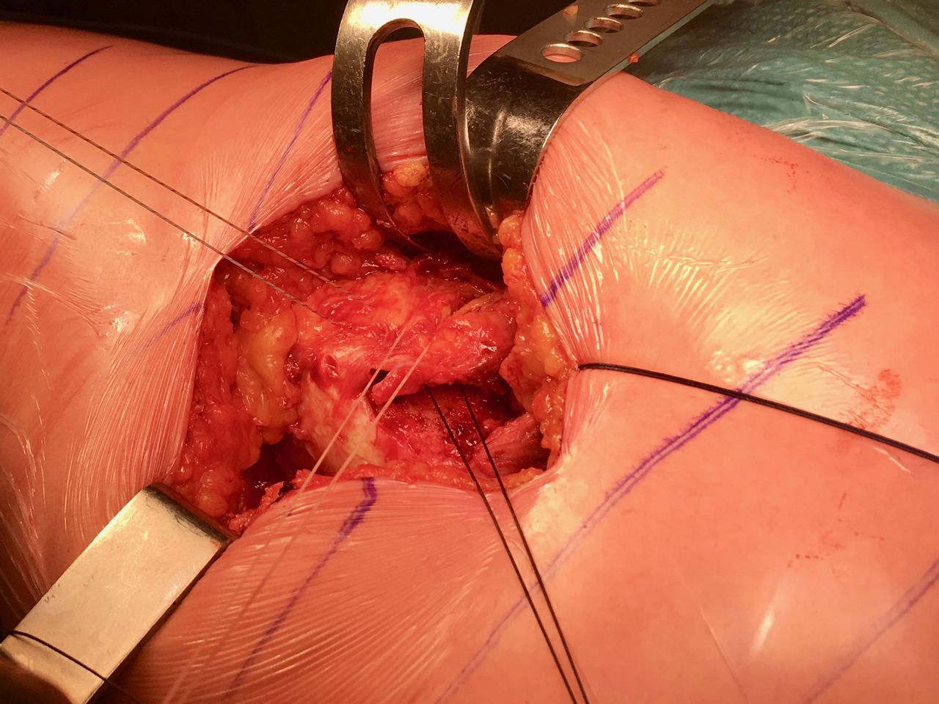
Open primary repair

Slide 43
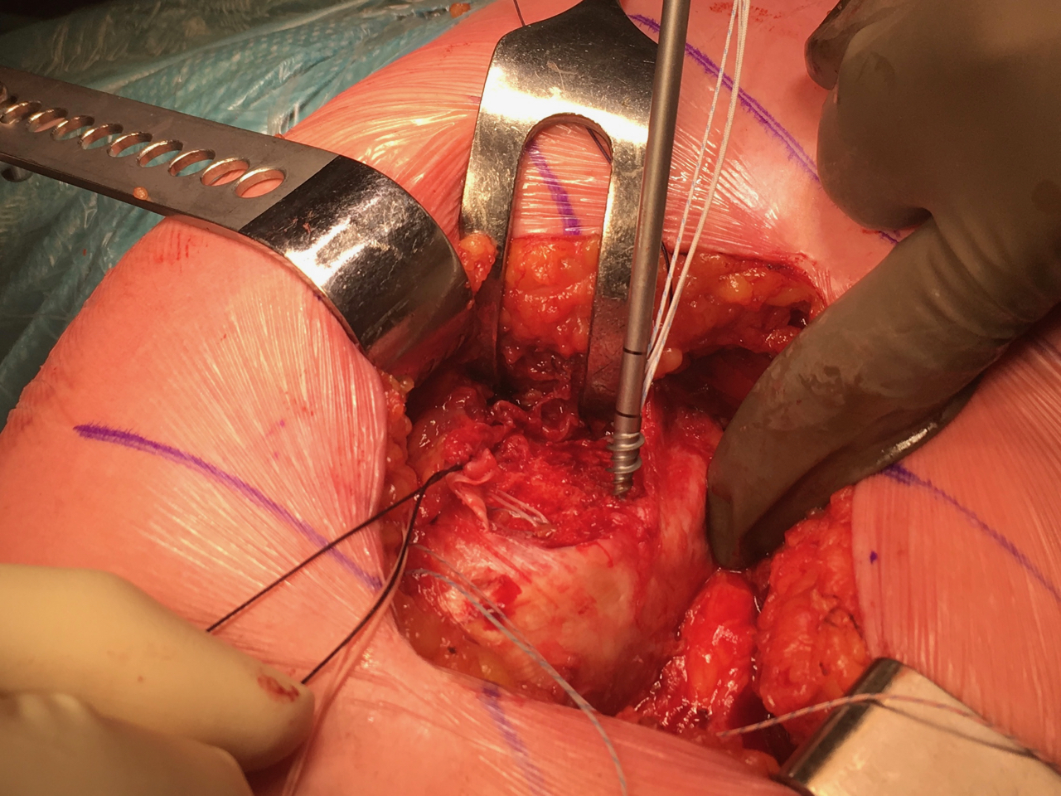
Open primary repair

Slide 44
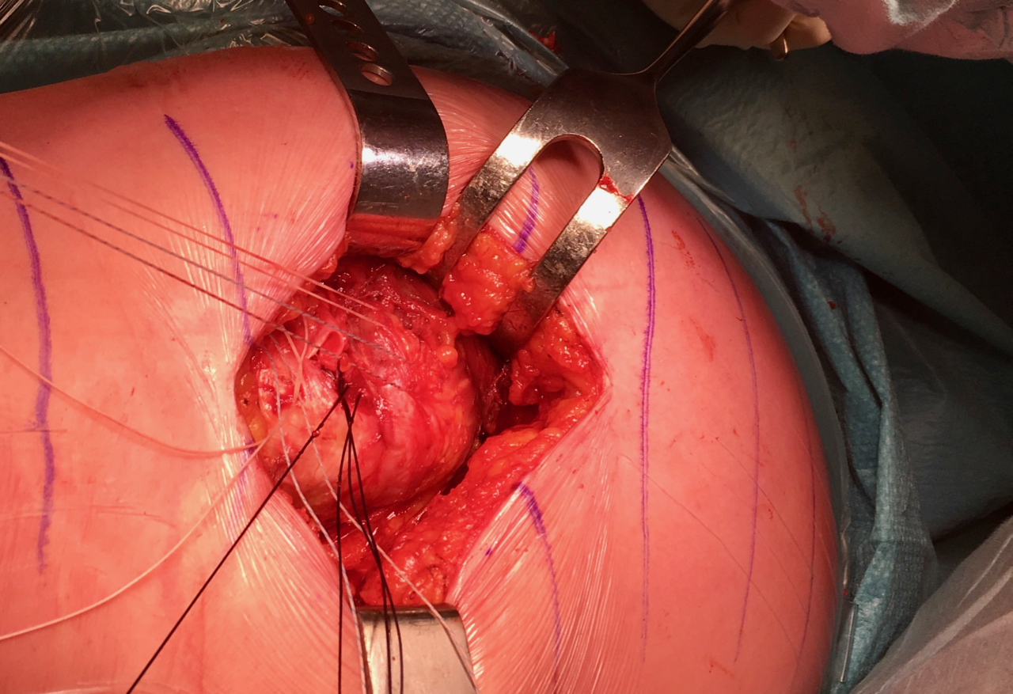
Open primary repair

Slide 45
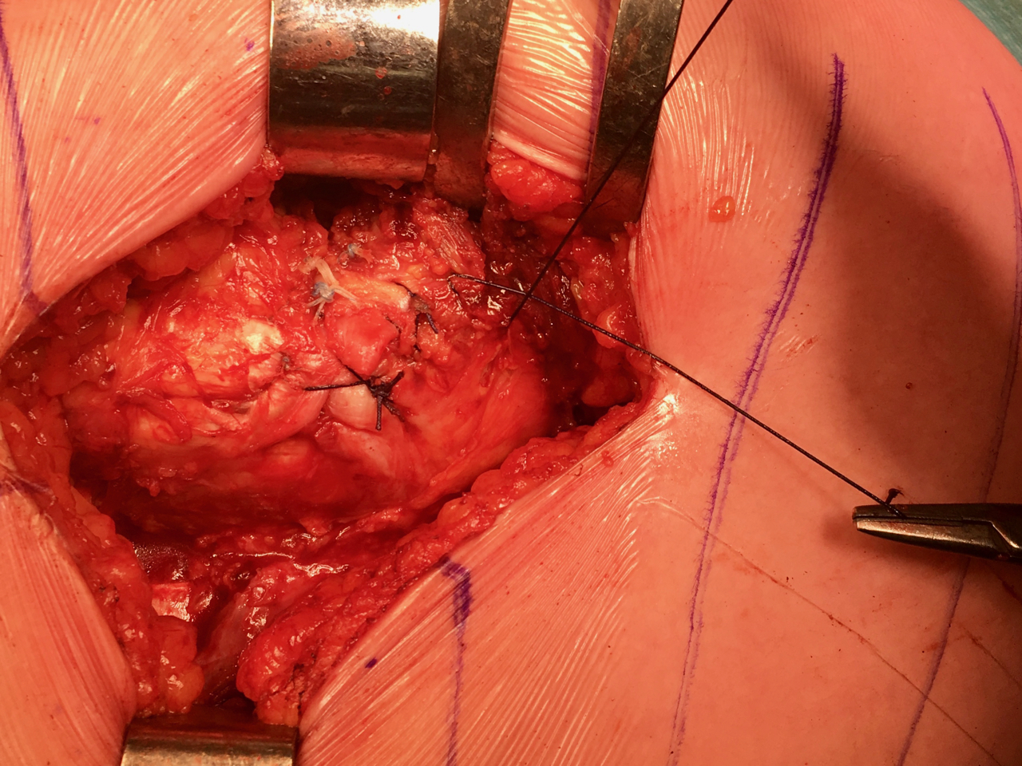
Open primary repair

Slide 46
Open primary repair
Close fascia
NO excision of fascia at greater trochanter
LIA
No drain – tranexamid acid (Exacyl)

Slide 47
Endoscopic repair

Slide 48
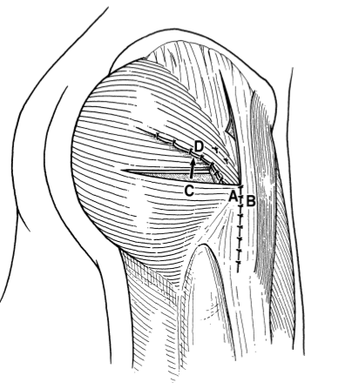
Transposition: Gluteus maximus transfert
Whiteside LA,
Clin Orthop, 2006

Slide 49
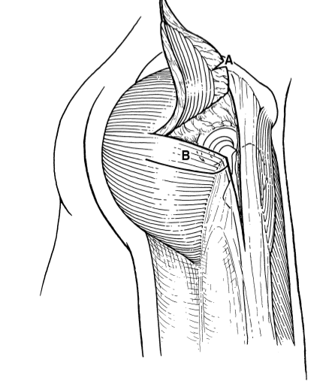
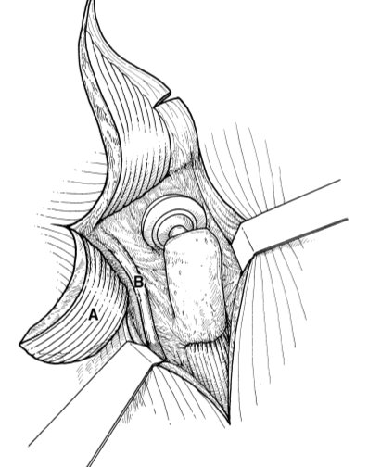
Transposition: gluteus max transfert (Whiteside)

Slide 50
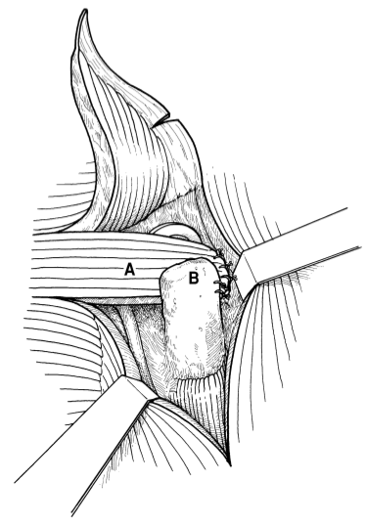
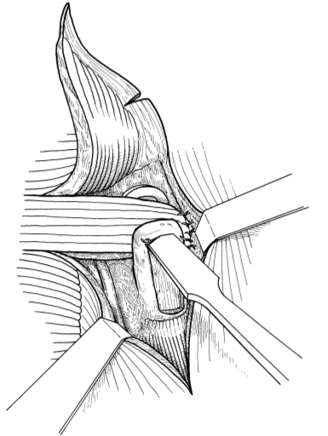
Transposition: gluteus max transfert (Whiteside)

Slide 51
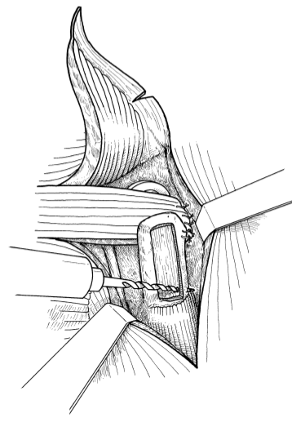
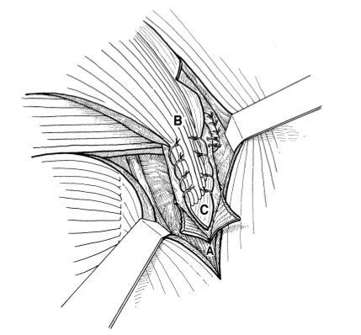
Transposition: gluteus max transfert (Whiteside)

Slide 52
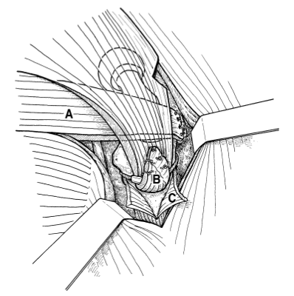
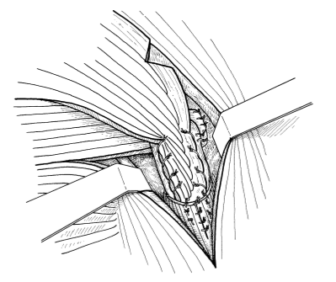
Transposition: gluteus max transfert (Whiteside)

Slide 53
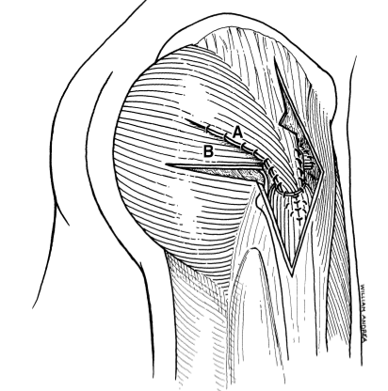
Transposition: gluteus max transfert (Whiteside)

Slide 54
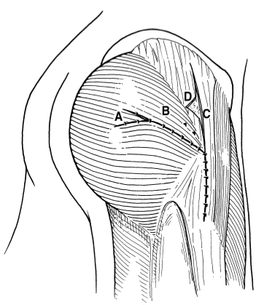
Transposition: gluteus max transfert (Whiteside)

Slide 55
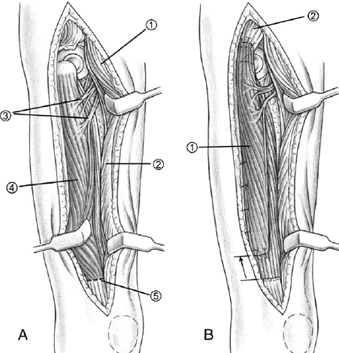
Transposition: vastus lateralis transfert
Beck M. J Arthroplasty 2004

Slide 56
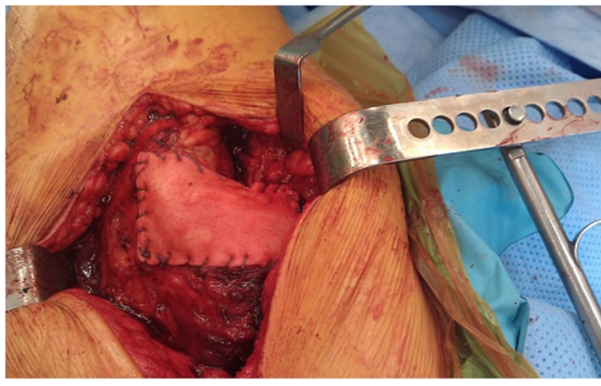
Augmentation
Graft Jack
LARS

Slide 57
Abductorcuff + THA
Coxarthrosis + abductorcuff tear
Open primary repair during surgery
Difficult with anterior approach, easier with posterior approach (DSA?)
Abductorcuff tear after THA
Often anterolateral approach
Primary repair not possible ?
Transposition: glut max transfert

Slide 58
Postoperative
Compression 2 to 4w
NSAID ?
Ice !

Slide 59
Postop rehab
Communicatie chirurg – revalidatie – kine
Operatieverslag:
Perop: wat is er gebeurd?
Postop: steunname
Voorschrift kine: 60x
Revalier: oefenschema

Slide 60
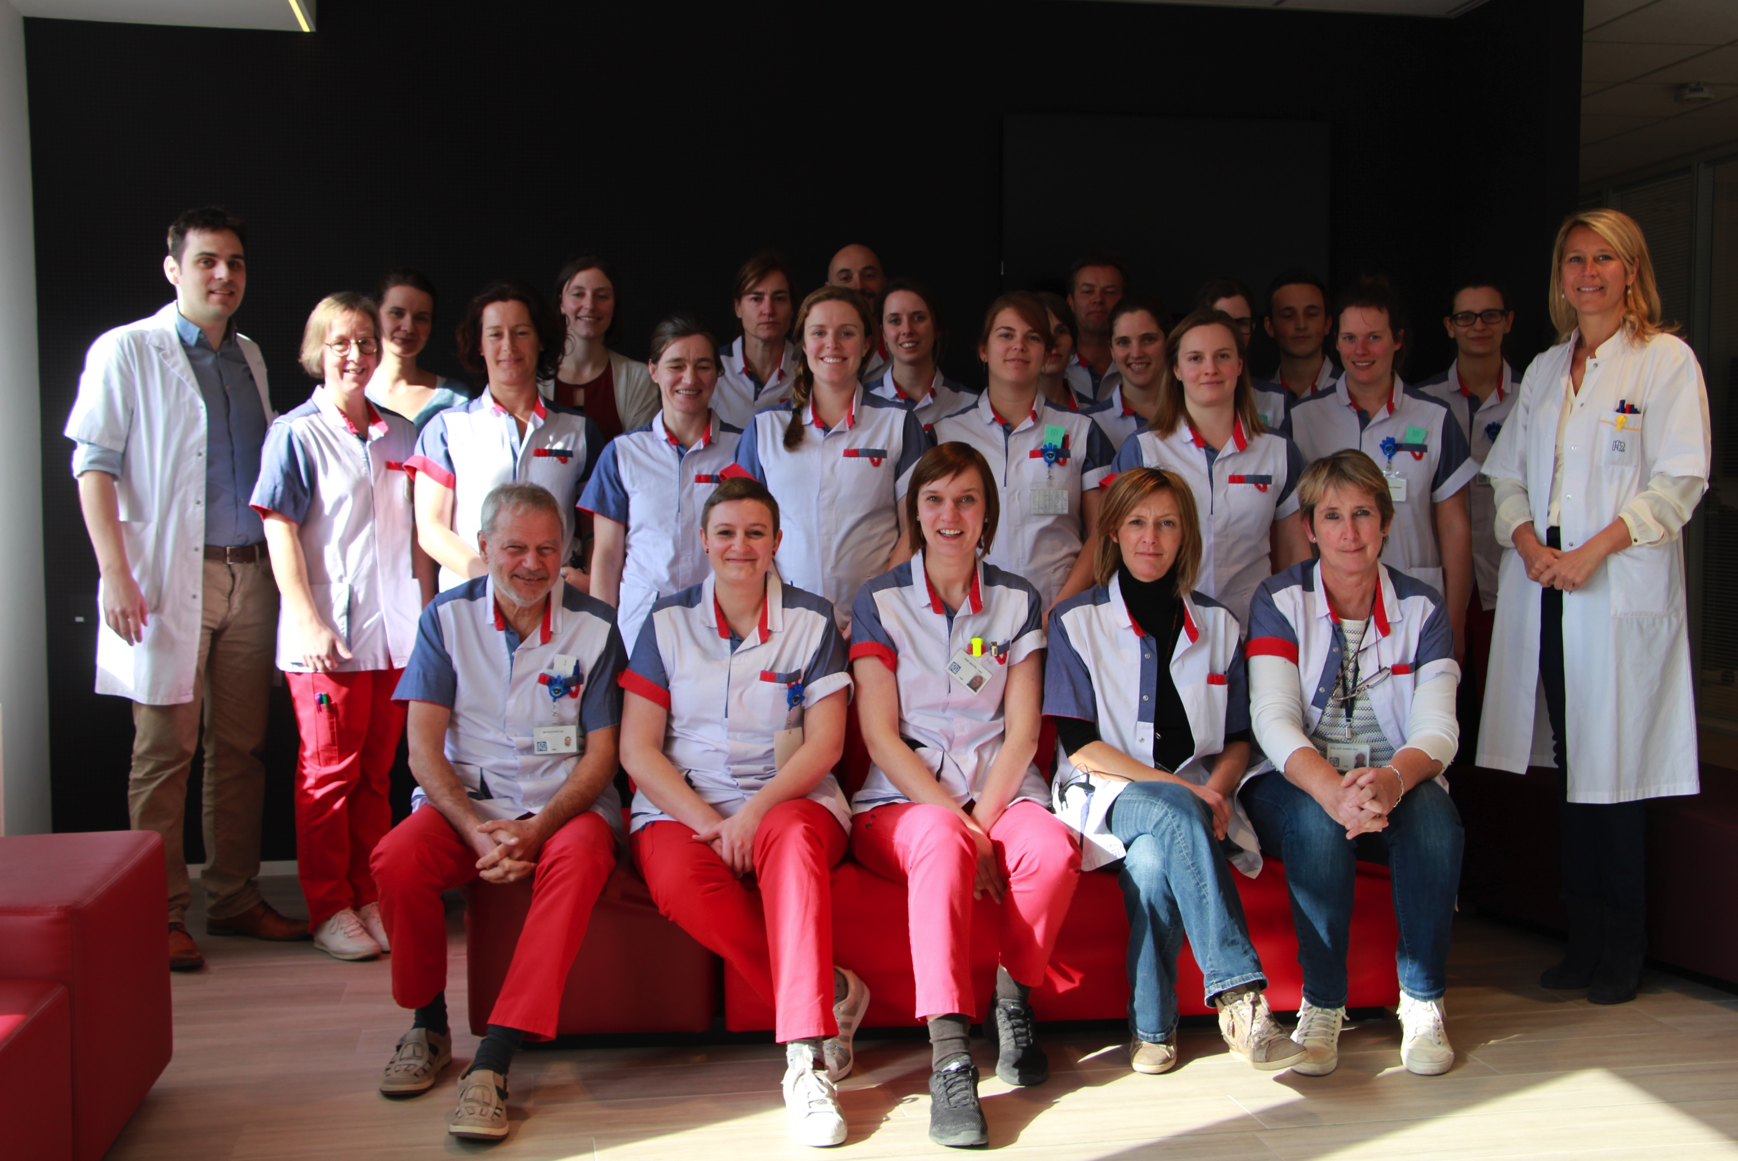
Postop rehab

Slide 61
Doelstellingen
0-6 weken | 6w-3m | 3m-6m | Na 6m
 | Gang opbouwen Met hulpmiddelen | Gang optimaliseren
ROM ↑
 | Kracht ↑ | Kracht ↑ | Sportspecifiek kracht ↑
Pijn ↓

Slide 62
 | 0-6 weken | 6w-3m | 3m-6m | Na 6m
Steunname | Partiële steunname = 2 krukken | Steunen adhv pijngrens Afbouwen krukken gebruik 1 kruk ➔ zonder hulpmiddel | Zonder hulpmiddel | Zonder hulpmiddel
Spieractiviteit Gluteus medius | Geen contractie toegestaan Passieve mobilisatie toegestaan | Contractie toegestaan | Krachtopbouw Spieruithouding verhogen | Sport specifieke krachtopbouw
Fiets | Hometrainer | Hometrainer/ fietsen indien mogelijk | Fietsen toegestaan | Stimuleren om veel te fietsen

Slide 63
Oefeningen 0-6w post-op
Gebruik compressie broek
Fietsen (Theratrainer)
Unipodale stand (niet-geopereerde been)
Bridging (gluteus maximus)
Adductoren aanspannen

Slide 64
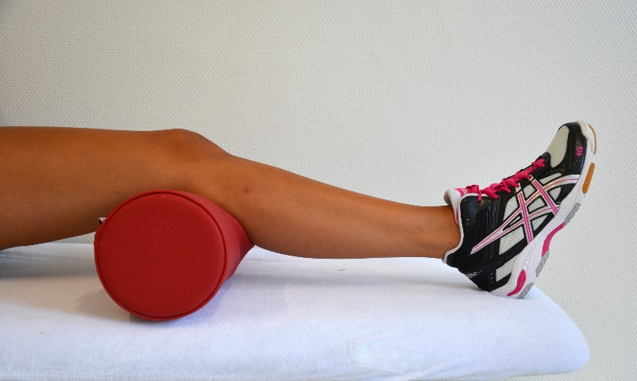
Oefeningen 0-6w post-op
Heel slides
(hamstrings/iliopsoas)
Heel digs (hamstrings)
Q-ceps setting/contractie
Co-contractie hamstrings + Q-ceps

Slide 65
Oefeningen 6w-3m post-op
Uitbreiding kracht- en stabilisatieoefeningen
Unipodale stand: abductie toegestaan
Bridging: strekken been toevoegen
Abductie in zijlig (gestrekt been + gebogen been)

Slide 66
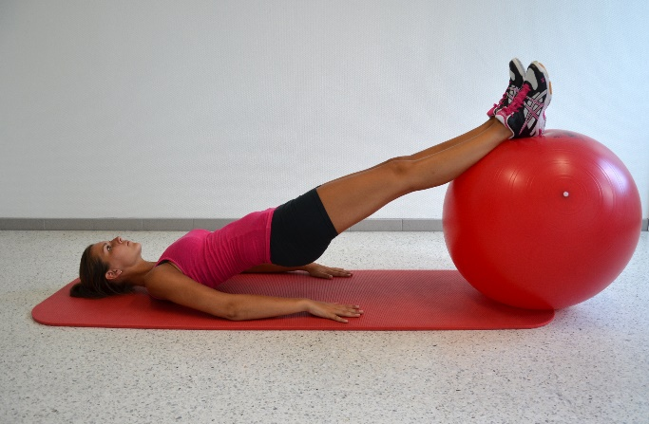
Oefeningen 3m-6m post-op
Opbouwen in kracht en stabilisatietraining
Bv. Squats, lunges, bridging op bobath bal, single knee bend
Opbouw oefeningen
Toevoegen proprioceptief materiaal
Toevoegen gewicht/theraband

Slide 67
Oefeningen >6m post-op
Sportspecifieke oefeningen
Vaak niet van toepassing

Slide 68
Conclusion
Greater trochanter pain syndrome: not only bursitis
Abductorcuff tendinopathy:
Tendinitis – partial (articular) tear – full thickness tear
Diagnosis: clinical investigation + MRI

Slide 69
Conclusion
Good indication for surgical repair
Clinical investigation:
Tenderness at palpation
Loss of abductor strength
Confirmed on MRI
Exclude other pathologies (FAI, coxathrosis, …)

Slide 70
Conclusion
Less pain
More function – no normal hip
Climbing stairs, walking
Sleeping on the side sometimes painfull
Adaptations: nordic walking, bicycle

Slide 71
Conclusion
Patients with patience
Realistic expectations

